Slide 1
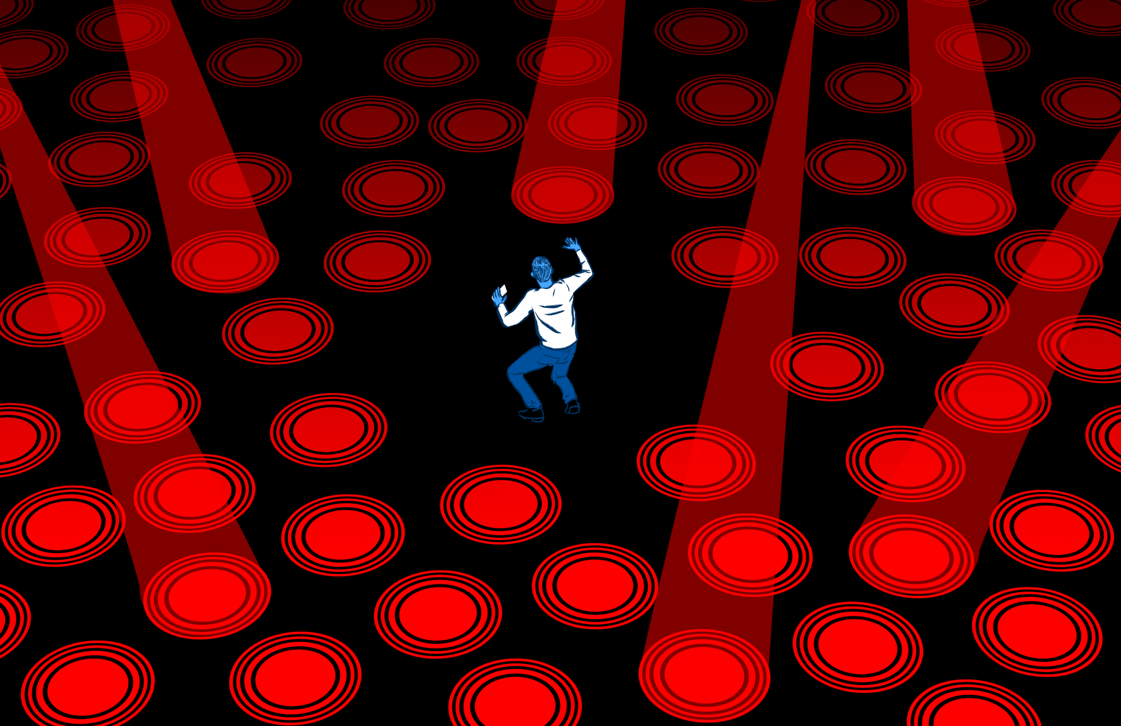
Duty of Disclosure – When is enough, ENOUGH!!?
Paranoia will Destroya
(“A” Prosecutor’s Perspective)
Mercedes K. Meyer, Ph.D., J.D.

Slide 2
AGENDA
What is the duty of candor?
Timing in Prosecution & Before USPTO
Conflict of Interest in Candor?
What do we need to submit?
Conflicting Rules
Fear of Correcting Mistakes
Bedtime reading – a really long paper beats…

Slide 3
Distinguishing DC from IC
“Duty of Candor” (DC) is an issue for the Patent Office
Rule 1.56(a) Today
“Each individual associated with the filing and prosecution of a patent application has a duty of candor and good faith in dealing with the Office, which includes a duty to disclose to the Office all information known to that individual to be material to patentability as defined in this section.”
“The duty to disclose all information known to be material to patentability is deemed to be satisfied if all information known to be material to patentability of any claim issued in a patent was cited by the Office or submitted to the Office in the manner prescribed by §§ 1.97(b)-(d) and 1.98.”
Inequitable conduct (IC) can involve duty of candor violations as well as other acts of “unclean hands” – duty of candor violations are a subset of inequitable conduct
Rule 56 only deals with patent prosecution

Slide 4
The Four Horsemen of the Duty of Candor Apocalypse
Dayco Prods. Inc. v. Total Containment, Inc., 329 F.3d 1358 (Fed Cir. 2003)
Report references from applications having substantially similar claims (“SSCs”) but not in the same family
McKesson Info. Solutions v. Bridge Medical, Inc., 487 F.3d 897 (Fed. Cir. 2007)
Report Office Actions and references in same family even with the same examiner, if it’s not a progeny application
Larson Mfg. Co. v. Aluminart Prods. Ltd., 559 F.3d 1317 (Fed. Cir. 2009)
Report all Office Actions (not just some) from a progeny application to a parent application
Report all applicant responses in a progeny application to its parent, OR only if there are contradictory arguments
Therasense
Report contradictory arguments made in a related foreign application
4
Notes:
http://www.istockphoto.com/stock-photo-14824249-four-riders-of-the-apocalypse.php?st=d0355c9

Slide 5
“What” to report?
References and materials from applications with substantially similar claims (SSCs) (Dayco)
Only applications with obviousness type double patenting rejections OR applications which may have SSCs
References and Office Actions from applications that are not immediate progeny (McKesson & Larson)
References from related foreign applications
MPEP 2001.06(a); 37 CFR 1.97-1.98
Contradictory arguments from related foreign applications??? (Therasense)
Materials from Litigation
MPEP 2001.06(c)
Application
with OTDP
rejection
Parent
Application
Progeny
Application
CIP
Application
RED = reporting requirements
5

Slide 6
“When” to report?
Payment of Issue Fee
Restriction
1st OA
FOA
File
Application
Patent
File IDS without
fees or certifications
if before 1st OA or 3 months
from filing the application or RCE
After paying the issue fee no IDS will be considered
File IDS with $180 fee
or make the certification under § 1.97(e)
File IDS with fee and make the certification under § 1.97(e)
Duty of candor under Rule 56 ends with patent issuance. 37 CFR §§ 1.56 & 1.98

Slide 7
Patent Grant Time Line Global Prosecution Twister
12 months
4-5 years unless you have the RCE 2 yr reboot
USPN
Grants
unless
PGR
Then IPR
US
app
File Provisional
EP/CN pros starts
Foreign apps eventually grant
Oppositions
Invalidity Proceedings
NZ/AU pros starts
KR/JP pros starts
CA pros starts
PCT enters national stage
30-31 mos
PCT filed
ISR issued
~19 mos.
Notes:
The problem is the time line of prosecution for getting a US patent to grant given the start and end times of prosecution abroad. You may have to continue to file RCEs to get IDSs in with relevant documents. And unfortunately other art can continue to flow in after a patent grants.
Additionally, Rule 501 for putting references in the file has changed, where you now have to make statements making that rule even less likely to be used.

Slide 8
Chronological Legal Change
2 sets of statutes next 20 yrs.
New PTO Ethics Rules
6/8/95
URAA
11/29/99
AIPA
5/29/00
12/10/04
9/16/2011
9/26/2011
9/16/2012
3/16/2013
PTA 154(b)
FITF
Derivation
Loss of interference
Repeal of statutory invention registration
PGR
Prioritized Exam
Claim of benefit – 1.78
Publication after 18 mos.
Inter partes reexamination
RCE v. CPA practice
Final rules for interferences and appeals (9/10/04)
2012
Prometheus
17 years from grant to 20 years from filing
CONS/DIVS/CIPS
2013
Myriad
CREATE Act 103(c)
Best mode
Virtual & false marking
OED Stat. of limitations
Micro entity status
PTE
Oath & Dec
Preissuance submission
Supplemental exam
IPR
PGR for business methods (CBM)
2014
Alice
2014
Nautilus
1997
Lilly
2007
KSR
2009
Bilski
2010
Ariad
2011
Classen
2011
Centocor v. Abbott
2014…
Akamai
2003
Dayco
2007
McKesson
2009
Larson
2011
Therasense
Notes:
Some legal changes in a time line version
101 – new types of art – what is in nature

Slide 9
Timing - 37 CFR § 1.97(e)(1)
(e) A statement under this section must state either:
(1) That each item of information contained in the information disclosure statement was first cited in any communication from a foreign patent office in a counterpart foreign application not more than three months prior to the filing of the information disclosure statement;

Slide 10
The Problems with § 1.97(e)(1)
US associate generally does not know about all related foreign applications and their prosecution when filing foreign origin applications
The cost of assessing whether a reference “was first cited” in “any” communication is higher than the $180 fee given the potential of inequitable conduct for making the certification
RECOMMENDATIONS: Pay fee OR request statement from foreign associate that § 1.97(e)(1) requirement has been met

Slide 11
37 CFR § 1.97(e)(2)
(e) A statement under this section must state either:
(2) That no item of information contained in the information disclosure statement was cited in a communication from a foreign patent office in a counterpart foreign application, and, to the knowledge of the person signing the certification after making reasonable inquiry, no item of information contained in the information disclosure statement was known to any individual designated in § 1.56(c) more than three months prior to the filing of the information disclosure statement.

Slide 12
The Problems with § 1.97(e)(2)
WHEN USED:
§ 1.97(e)(2) applies to applications with substantially similar claims in US cases
§ 1.97(e)(2) can be used for reporting USPTO Office Actions and Applicant responses
WHO CERTIFIES:
The US attorney makes the certification, BUT s/he may not know all the cases with substantially similar claims (SSCs) in order to make the certification
The US attorney has to certify for everyone subject to the duty of candor
PROBLEM:
The certification appears to place an unreasonable burden on the person certifying
Certification concern may require an RCE
RECOMMENDATIONS:
Have your foreign associate indicate that the (e)(2) certification can be made, OR
Pay the fee, because the $180 fee is cheaper than (1) determining whether all cases with substantially similar claims, and (2) all people subject with a duty of candor (3) who may be in other countries have met their duty
AND the $180 fee is cheaper than the potential of finding inequitable conduct

Slide 13
“How” to report?
The PTO has provided no formal guidance on “how” Applicants report certain non-patent items (i.e., on sale bars and office actions)
US Office Actions & Replies from related cases
QUESTIONS: Do we just cite the related application / patent OR do we also have to provide copies of all Office Actions / Replies, when the USPTO already has copies?
37 CFR § 1.98 requires a copy of non-US patent publications for them to be acknowledged and listed on the face of the patent
Manner of citing non-reference materials from related foreign applications (e.g., search reports, declarations, Applicant replies with contradictory arguments, etc.)
PROBLEM: The lack of USPTO guidance has resulted in occasional disparate treatment of IDS’s by Examiners
PROBLEM?: No IDS equivalent for IPRs / PGRs / CBMs and little guidance
Notes:
The “HOW TO” aspect of reporting art has also been something that we have asked for over the years from the USPTO, but they fail to provide guidance. Such as:
How do you want Office actions cited – do we really need to provide those?
How do you cite on sale prior art.
And going forward, are foreign language documents without translations going to be reviewed by the office given the new 102 requirements.

Slide 14
Conflicts of
Interest?
If filed after final rejection and 1.97(e) certification is to be avoided, then an RCE must be filed
More PTA – reporting in 30 days – a disconnect between 1.97(e) & 1.704(d)
NOTE: An RCE can impact patent term adjustment (PTA) and overall application pendency, which can be important to pharmaceutical patents and leads to more potential art in ~2 yr RCE induced delay
Notes:
(d)
(1) A paper containing only an information disclosure statement in compliance with §§ 1.97 and 1.98 will not be considered a failure to engage in reasonable efforts to conclude prosecution (processing or examination) of the application under paragraphs (c)(6), (c)(8), (c)(9), or (c)(10) of this section, and a request for continued examination in compliance with § 1.114 with no submission other than an information disclosure statement in compliance with §§ 1.97 and 1.98 will not be considered a failure to engage in reasonable efforts to conclude prosecution (processing or examination) of the application under paragraph (c)(12) of this section, if the paper or request for continued examination is accompanied by a statement that each item of information contained in the information disclosure statement:
(i) Was first cited in any communication from a patent office in a counterpart foreign or international application or from the Office, and this communication was not received by an individual designated in § 1.56(c) more than thirty days prior to the filing of the information disclosure statement; or
(ii) Is a communication that was issued by a patent office in a counterpart foreign or international application or by the Office, and this communication was not received by any individual designated in § 1.56(c) more than thirty days prior to the filing of the information disclosure statement.
(2) The thirty-day period set forth in paragraph (d)(1) of this section is not extendable.

Slide 15
Business Check – Budget Time & That’s if the product doesn’t get abandoned
Total over 20 years = ~ $365,000, but does not include going regional in Europe
Notes:
Assuming a 20 page applications with 20 claims and firm fees of 3K-11K for writing an application, you are trying to minimize costs.
And this does not take into account the costs for going regional stage in the EU.
Developed using software a few years ago.
Numbers are low. Add another amount for the US of about 20K for writing and prosecuting.

Slide 16
Reissue/Reexam v. IPR/PGR/CBM
Can open to amend
Can file an IDS citing all identified uncited art
Oppositions, invalidity proceedings, other offices
1.555(b) Reexam - (b) information is material to patentability in a reexamination proceeding when it is not cumulative to information of record or being made of record in the reexamination proceeding
Amendments very, very rare
37 CFR 42.101 (IPR), 42.201 (PGR), & 42.302 (CBM) – different rules, different candor requirement
Cannot do an IDS
Can seek to bring forward specific references
NOTE: Information from related litigation – MPEP 2001.06(c)/1.56 does not apply
Notes:
So that is the background.
So if you compare reissue and reexam – very different. Reissue you reopen prosecution and can submit new art.
Reexam – I have submitted and seen submitted hundreds of documents in IDSs.
NOT TRUE FOR IPR / PGR / CBM
No IDS dump permitted.
You can do a motion to add new evidence that you think is material to any proposed claim amendments. But as you will see, MPEP 2001.06 and 1.56 do not apply to these types of cases. And even all the art cited in a related litigation does not have to be cited.
IPR2013-00229, Paper 27, PCT International, Inc. v. Amphenol Corp.
Patent Owner became aware of additional prior art cited in corresponding EP application. Patent Owner sought advice from PTAB on how to handle duty of candor under 37 CFR 42.11
Board determined that there was no basis for concluding that consideration of the supplemental information would be practical or in the interests of justice under 37 CFR 42.123(c)
TAKE AWAY: It depends on the case – Request a Motion to introduce new prior art as supplemental information under 42.123(c)

Slide 17
IPR / PGR / CBM –What to include?
IPR – not a patent examination or reexamination
Proposed substitute claims are only “proposed”
Patent Owner must show patentable distinction of the proposed claim over the prior art
The burden is not on the petitioner to show unpatentability of the proposed substitute claims
See IPR2012-00027, Paper No. 26, Mot. To Amend Claims, Idle Free Systems, Inc. v. Bergstrom, Inc.
Notes:
Idle Free is the case that EVERYONE CITES to for showing patentability of the claims.

Slide 18
Idle Free Prior Art of Record
Any material art in the prosecution history of the patent
Any material art of record in the current proceeding, including art asserted in grounds on which the Board did not institute review; and
Any material art of record in any other proceeding before the Office involving the patent
Does not appear to include material from related district court litigations & foreign office actions
See IPR2015-00040, Paper 42, MasterImage 3D, Inc. v. Reald Inc.
Notes:
MasterImage helped to further define Idle Free

Slide 19
IPR2015-00040 MasterImage 3D, Inc. v. Reald Inc.
There is a duty for the patent owner to disclose not just the closest primary reference, but also closest secondary reference(s) and teachings of which sufficiently complement that of the closest primary reference to be material to the added limitation
Order Conduct of Proceedings, Paper No. 42, p. 3

Slide 20
What about foreign proceedings and other litigations?
It depends...given the claim
Look to IPR2013-00229, Paper 27, PCT International, Inc. v. Amphenol Corp.

Slide 21
Ex parte Bollman, D2010-40: Filed 6 boxes of IDS documents in 4 cases of which some of the documents were under a district court protective order; it was concluded that Mr. Bollman failed to read, review, or inspect the references to realize some documents were under the protective order and thus made false certifications to the Office
Attorney was reprimanded and placed on probation
Notes:
Bollman – This is perhaps the most interesting from a duty of candor / fraud standpoint, but not what we usually think of.
William Bollman was a DC registered patent attorney. He had prosecuted a patent now in district court litigation. There was a protective order that would not allow any prosecuting attorney to see the documents. Bollman was not a signatory, but he knew about the protective order. Subsequently the patent entered into reexamination. Bollman received 6 boxes of documents for an IDS, including several documents under the protective order. As these documents were entered without an indication of confidentiality, they were public, despite the protective order entered by the district court.
Bollman then filed the documents in the 3 related applications of his own initiative. Without direction of the client. Thereby violating the protective order again. The court went on to hold IDS in contempt of court and ordered to pay costs and attorney fees of 332K.
Therefore Bollman was found to have violated 10.23(a),(b), (c)(15) by the signing and filing of an IDS without review. This resulted in a public reprimand and 2 year probation.
MORE SEVERE
Edelson – patent attorney from Illinois. He didn’t always inform his client of Office correspondence including Notices of Abandonment. He misrepresented the status of the abandoned trademarks and patent / PCT applications to the client and said everything was fine. He failed to revive them. And, just to really mess himself up, he provided false or misleading information to OED during the investigation of his misconduct! Don’t do that! Thus, frauds were committed under 10.23(c)(2)(i), (b)(4), and (b)(5) amongst violating a host of other disciplinary rules.
He was suspended for 36 months / 3 years.
Massicotte – Michelle Massicotte was a Massachusetts attorney but not a registered patent attorney. She received office actions for 3 trademark applications which went unanswered and then abandoned. During revival, the attorney asserted that she did not receive the office actions before the trademarks went abandoned. This is an example of an AVERMENT. This was a fraud and a violation under 10.23(b)(4), (b)(5), and (b)(6) with false or misleading information to the office.
The APJ again pointed out that there were no prior disciplinary actions, conduct was aberrational, and there were extenuating medical circumstances. Thus she was suspended to do anything before the USPTO for 2 years.

Slide 22
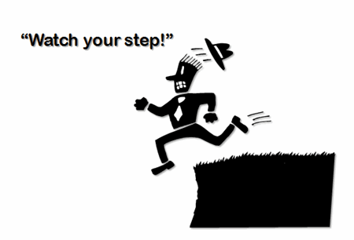
Certifications & Candor
Small entity / microentity assertions
Certificates of mailing / transmission
Correction of inventorship
Duty to disclose and certifications under 1.97(e)
Declarations under 1.131 and 1.132
Revival of abandoned applications
Revival for failure to pay maintenance fees
Reissue oath / declaration
Nonpublication request under 37 CFR 1.213
Certificate of correction
Declaration for sequence listings
Retroactive petitions for foreign filing licenses
Certifications for ex parte and inter partes reexaminations
Terminal Disclaimers.
Inventor Declarations - In re Chan (D2011-21)

Slide 23
Correcting your mistakes
Mistaeks Happen. We are human. We are not Perfect.
Oops!!!

Slide 24
Fixing Mistaeks Mistakes
Declaration Errors Happen – really
Wireless, Inc. v. HTC Corp., 732 F.3d 1339 (Fed. Cir. 2013) 1.131 Declaration error
42.104(c) is entitled to LIBERAL INTERPRETATION
DON’T WAIT TO CORRECT MISTAKES!
But don’t contact ex parte either – In re Caracappa, D2014-02, § 11.304.
IPR2014-00367, Paper 54
Exhibits were omitted – 3 month delay in trying to submit exhibits by Patent Owner – not granted
IPR2013-00624, Paper 22
Petitioner made a clerical error and failed to click the “Submit” button in PRPS. Petitioner had a petition that satisfied the requirements on the earlier date – PTAB granted the earlier effective date
See also IPR2015-00239-243 and -247, Paper No. 10 – one day difference
Notes:
IPR2014-00367 – Schott Gemtron Corporation v. SSW Holding Company Inc. (Patent Owner) Paper 54. There was a 25 day delay in requesting the conference call to deal with getting the missing exhibits in. That delay weighed AGAINST granting the request to get the exhibits entered. The Motion to Correct the Response correcting typos in the response was viewed as NOT resulting in prejudice. DO NOT WAIT.
IPR2013-00624, ConMed Corp. v. Bonutti Skeletal Innovations LLC, Paper 22, Mar. 14, 2014: Did the Petitioner hit the SUBMIT button on Sept. 25 v. October 2. Board said that as the Petition was complete and served on other side they would grant the Sept. 25th date.
IPR00239-243 and 247 – 2Wire, Inc. v. TQ Delta LLC, Paper 10, Jan. 15, 2015. Failure to hit the “SUBMIT” button on Nov. 6th and realizing that on Nov. 7th. All requirements for the petition had been met on Nov. 6th according to the PTAB.
IPR2015-01332 – Presidio Components Inc. v. Avx Corp (Patent Owner) involves a case where the declaration as filed with the PTAB was unsigned by the Petitioner’s declarant. No credible prejudice was shown by AVX, and none called to the attention of the court. Mistakes happen.

Slide 25
Conclusion
Be timely in fixing mistakes – if you don’t know how to do it, ask for directions
Organization –
Checklist of what to submit
Make sure it is acknowledged by the Examiner
Educate your team (admins / paralegals / docketers) – lots has changed in 10 yrs
Use of software like IPDAS, Optimizer, etc.
Foreign associates – constant reminders & education
Invention disclosure forms that include closest art

Slide 26
These materials are public information and have been prepared solely for educational and entertainment purposes to contribute to the understanding of U.S. intellectual property law and practice. These materials reflect only the personal views of the speaker and are not individualized legal advice. It is understood that each case is fact-specific, and that the appropriate solution in any case will vary. Therefore, these materials may or may not be relevant to any particular situation. Thus, Drinker Biddle & Reath LLP, and the speaker cannot be bound either philosophically or as representatives of their various present and future clients to the comments expressed in these materials. The presentation of these materials does not establish any form of attorney-client relationship with the firm or the speaker, or any combination thereof. While every attempt was made to insure that these materials are accurate, errors or omissions may be contained therein, for which any liability is disclaimed.
And nothing represents the views of any sentient life form on the earth or universe, or any parallel universe, alive or dead, fictitious or real! This is for entertainment purposes only.

Slide 27
Thank You!
Mercedes K. Meyer, Ph.D., J.D.
Mercedes.Meyer@dbr.com
(202) 842-8821
LinkedIn: https://www.linkedin.com/in/mercedesmeyer
Bio: www.drinkerbiddle.com/people/attorneys/meyer-mercedes-k
PTAB Blog: http://ptabtrialblog.com/
Twitter: @MercedesMeyer
1500 K Street NW
Suite 1100
Washington, DC 20005
(202) 842-8800
(202) 842-8465 fax
www.drinkerbiddle.com
CALIFORNIA | DELAWARE | ILLINOIS | NEW JERSEY
NEW YORK | PENNSYLVANIA | WASHINGTON DC | WISCONSIN
© 2016 Drinker Biddle & Reath LLP | All rights reserved.
A Delaware limited liability partnership

